Slide 1
Smart Vehicle
Review 3

Slide 2
Team Members
Jigyasa Agarwal - 19BPS1056
Navansh Goel - 19BPS1065
S Deeksha - 19BPS1090

Slide 3
Abstract
Smart service provision systems can provide comfort to people during car rides. The development of these systems faces a number of issues that relate to the analysis of numerous factors, which are influenced by various factors like weather conditions, occupancy, etc. To ensure that the smart service provision system can assist with the analysis of specific cases of unforeseen and uncomfortable situations during car rides, the system must have additional adaptability. To address the adequate provision of contextual data, we examined the problems of multi-dimensional definitions of contextual data and the choice of appropriate context-aware methods for recognition of contextual information.

Slide 4
Detailed Description of the System
The proposed methodology is based on methods of smart system architecture development that integrate the identification of context-aware data, conceptual structures of data warehouses. A Smart Vehicle needs to provide a comfortable journey. Our System aims at understanding the different context aware behaviours that can increase ease of use for the user. Adaptive behaviours like Automatic Wipers, Automatic Sun Shades and Sun roof, Automatic Temperature Control and Smart Windows can be very useful. The system adapts according to the different constraints and changes according to the comfort level of the people inside the car.

Slide 5
List of Primary context aware behaviours of the System
Change the temperature and airflow/air when a person enters car
Start wipers on rain and increase speed based on rain intensity
Roll up the Sun Shades when intensity of sun rays crosses threshold, roll down otherwise
Stop rolling up of window when movement/obstacle detected between window frame

Slide 6
Data Set Details and Programming Language
Programming Language to be used: Python
Dataset : Synthetic
The Dataset is used as a whole for all the behaviors
(PTO)

Slide 7
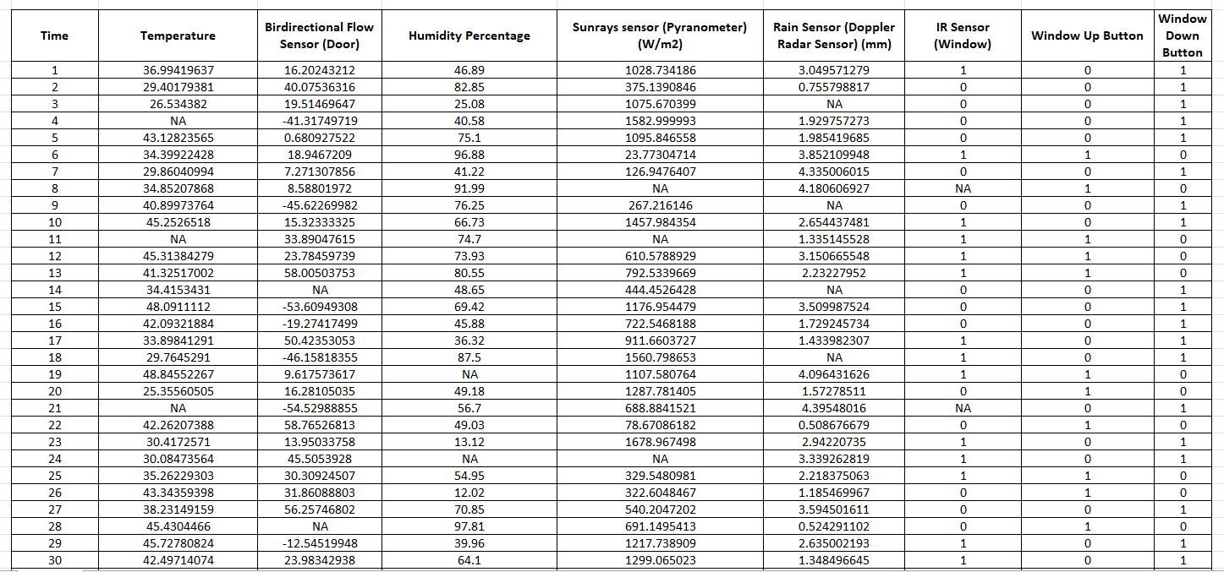

Slide 8
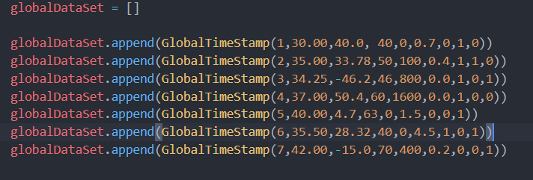
Code and Classes for Dataset
We store the entire dataset inside an array; GlobalDataSet [], made up of class objects GlobalTimeStamp.

Slide 9
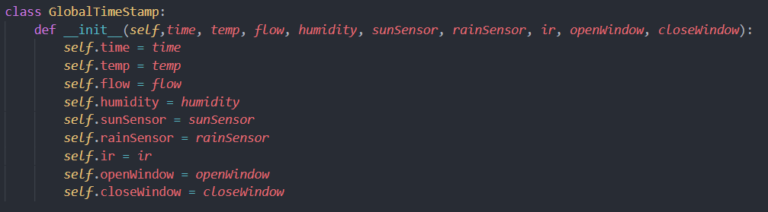
GlobalTimeStamp Class
The GlobalTimeStamp stores all the sensor values and acts as a Global Data Object

Slide 10
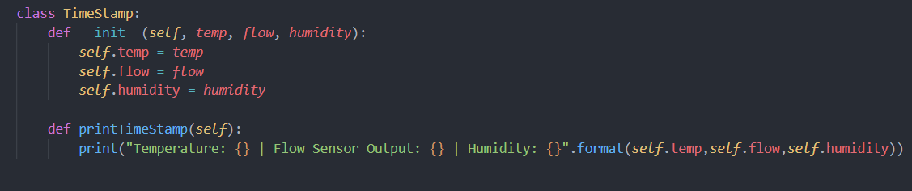
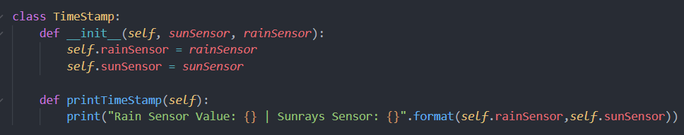
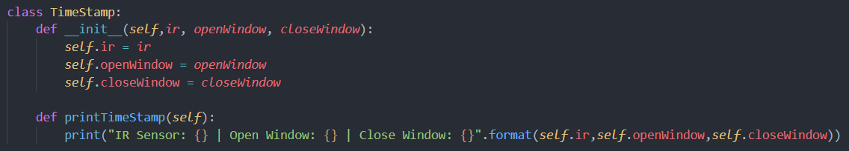
TimeStamp Class
We further store the specific sensor values into TimeStamp Classes
For Behavior 1
For Behavior 2 and 3
For Behavior 4

Slide 11
Change the temperature and airflow/air when a person enters car
Whenever a Person enters the car, the AC as well as the fan is switched on. The Fan speed is increased and the AC temperature is decreased in case more people enter the car.
This is to ensure proper ventilation inside the car.
Use of bidirectional flow sensor allows detection of direction of movement
These sensors can be fitted in the car door frame and can signal the central unit of the car to increase or decrease the temperature/fan speed accordingly
Active Behaviour: Increase in Fan Speed
If it is detected at any point that some people have left the car, then the AC and duct air flow are adjusted accordingly.

Slide 12
Change the temperature and airflow/air when a person enters/exits the car:
` Entities:
People
Attributes :
Number of people in car
Vent Duct
Attributes:
Power
Vent Duct Status
AC
Attributes:
AC Flow
AC Status

Slide 13
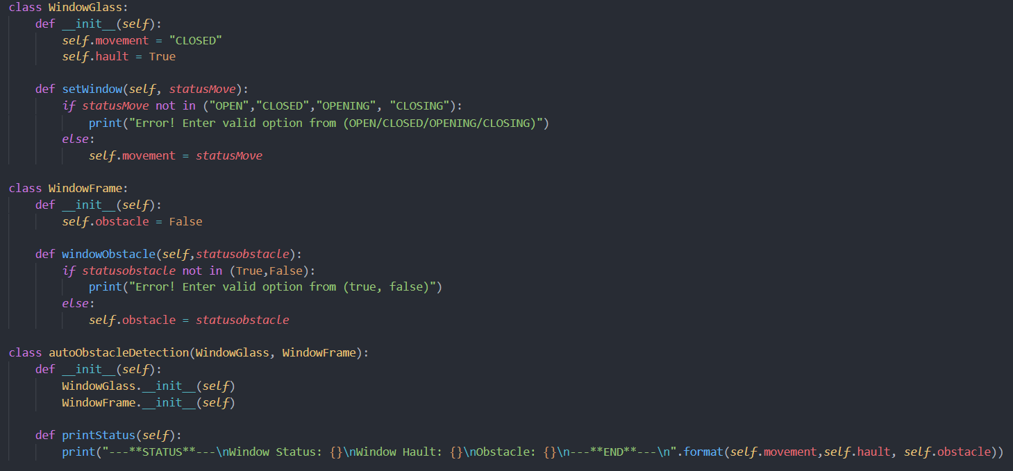
Classes and Entities for Behavior 1

Slide 14
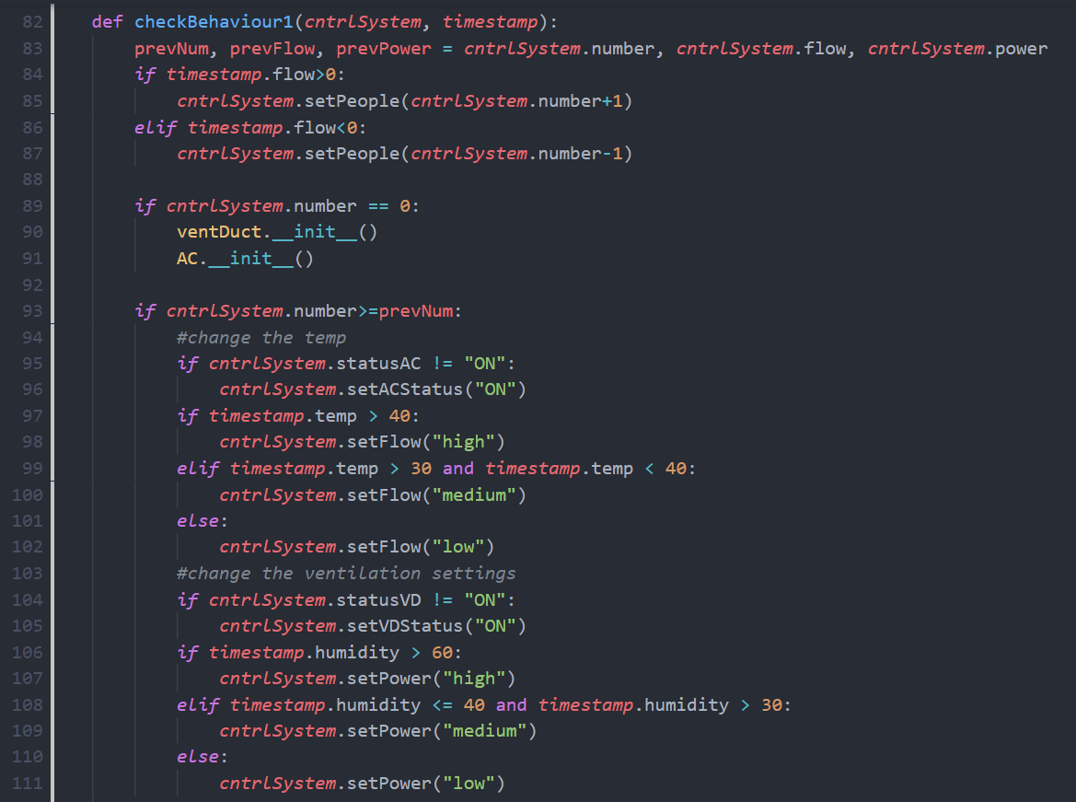
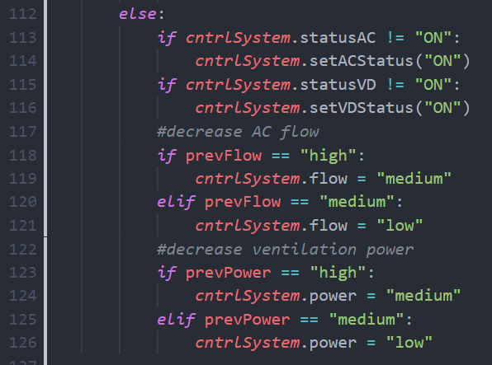
Context Behaviour Code for Behavior 1

Slide 15
Start wipers on rain and increase speed based on rain intensity
Whenever the weather condition indicates rain, car wipers will start automatically
Based upon the intensity of rain, wiper speed will increase/decrease.
Once it stops raining, the wipers will stop automatically.
The user is suggested an option to open their sunroof based on the intensity of sunlight taken from the Pyranometer
If the sunlight intensity is very high, close the sunroof automatically
Doppler Radar sensor is used for detecting the precipitation intensity and raindrop size falling on the window glass.
Switching on wipers and closing the sunroof comes under active context.
Opening sunroof comes under passive context.
Conflict Resolution- If the sunroof is open and it is raining, the sunroof will close automatically.

Slide 16
Start wipers on rain and increase speed based on rain intensity, open/close sunroof
Entities
Wipers
Attributes:
Wiper Status
Wiper Speed
Sun Roof
Attributes:
Sun Roof Status
Weather
Attributes:
Sun Status
Sun Intensity
Rain Status
Rain Intensity
Monitor
Attributed:
Notification

Slide 17
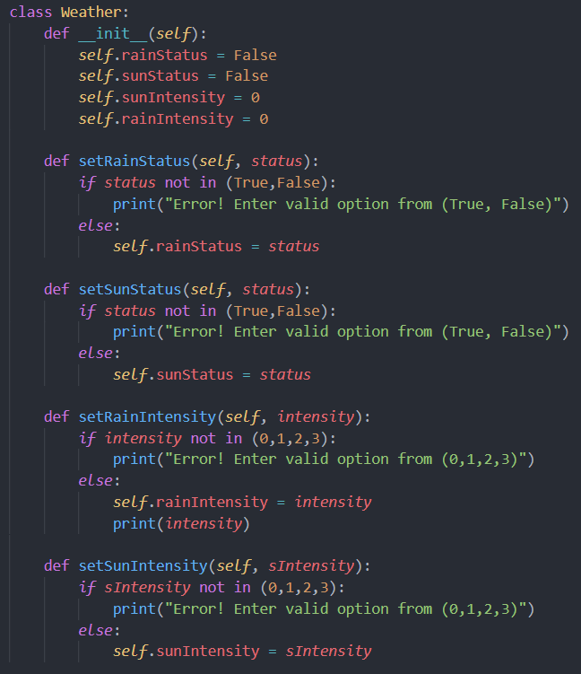
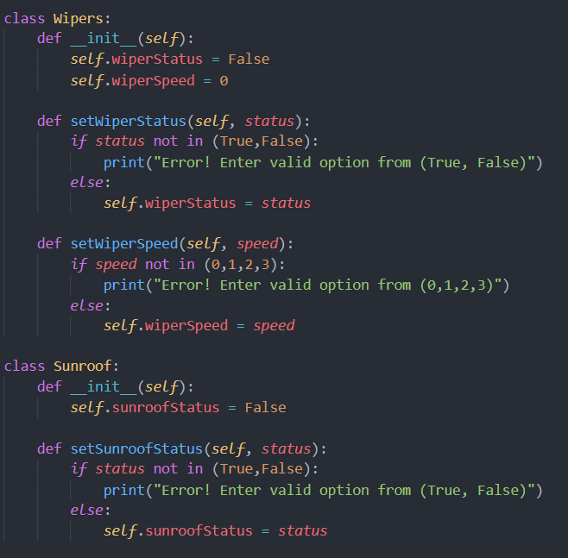
Classes and Entities for Behavior 2

Slide 18
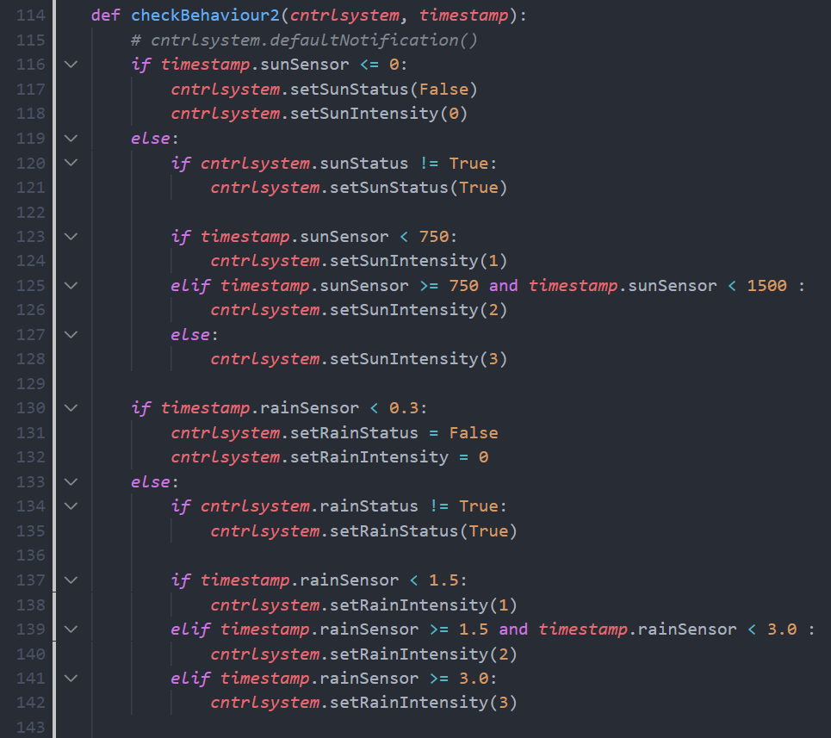
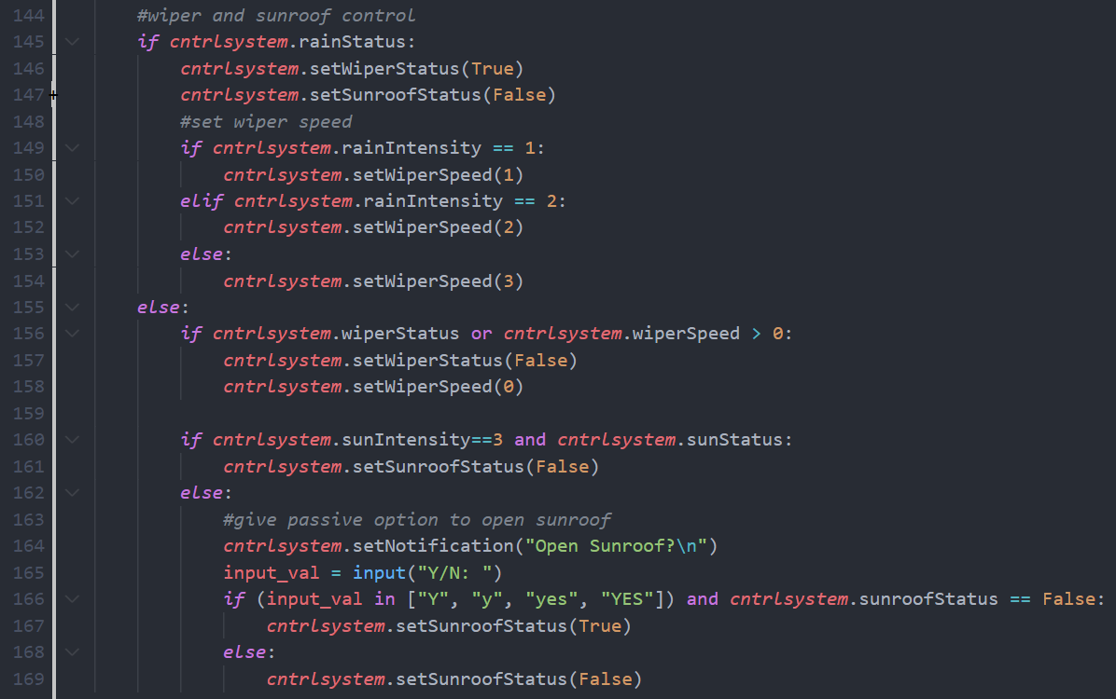
Context Behaviour Code for Behavior 2

Slide 19
Roll up the Sun Shades when intensity of sun rays crosses threshold, roll down otherwise
Active: We will be using a Pyranometer sensor to detect the intensity of the sun rays, based on which the decision will be take whether to roll down the shades or not
This will be a passive context behavior, as the user will be prompted on their monitor screen whether they want to roll down/up the sunshade
If the sun intensity is very high, i.e intensity=3, the user will be asked if they would like to close the sunshade.
Conflict Resolution- if the windows are rolled down, then you cannot close the sunshades.

Slide 20
Roll up the Sun Shades when intensity of sun rays crosses threshold, roll down otherwise
Entities
Sun Shades
Attributes:
Sunshade Status
Monitor
Attributes:
Notification
Weather
Attributes:
Sun Status
Sun Intensity
Rain Status
Rain Intensity

Slide 21
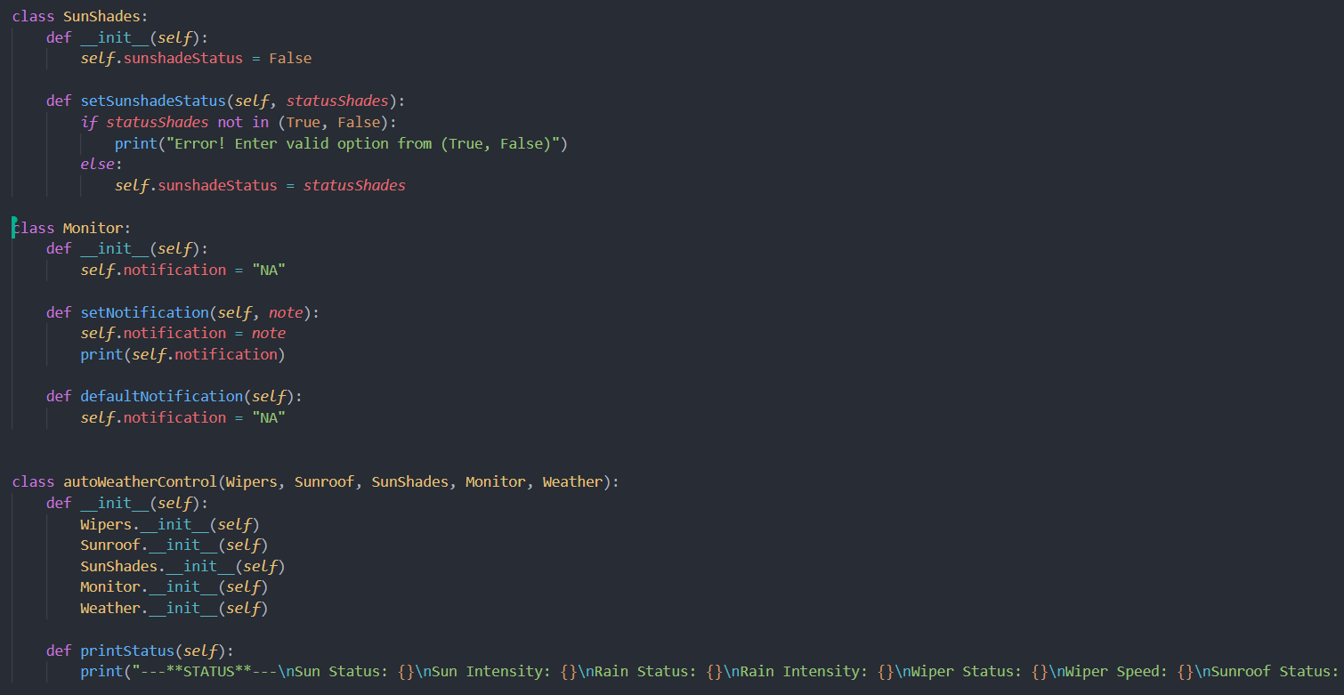
Classes and Entities for Behavior 3
The autoWeatherControl class in also common for Behaviour 2

Slide 22
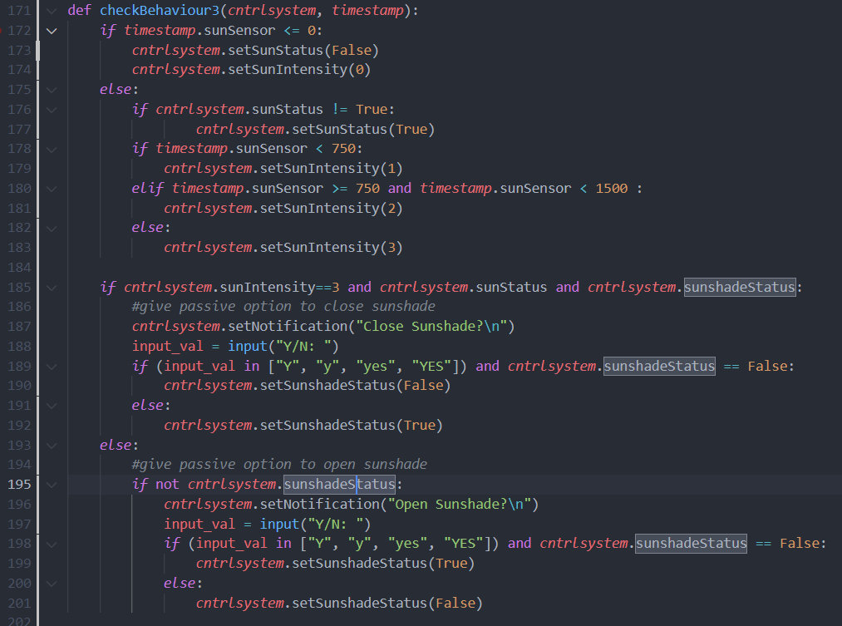
Context Behaviour Code for Behavior 3

Slide 23
Stop rolling up of window when movement/obstacle detected between window frame
This context aware behaviour incorporates safety aspects of a glass window in a vehicle.
In case of some obstacle or body parts between the window frame and the window glass, the window will not close.
If the window is closing, it will stop instantly till there is someone/ something between the frame and the glass.
The user has to prompt the window closing button again, in order to close it completely.
Use of Bidirectional Sensor to detect movement and direction between window frame
Active Context Aware Behaviour

Slide 24
Stop rolling up of window when movement/obstacle detected between window frame
Entities:
Window Glass
Attributes
Movement
Hault
Window Frame
Attributes
Obstacle detected

Slide 25
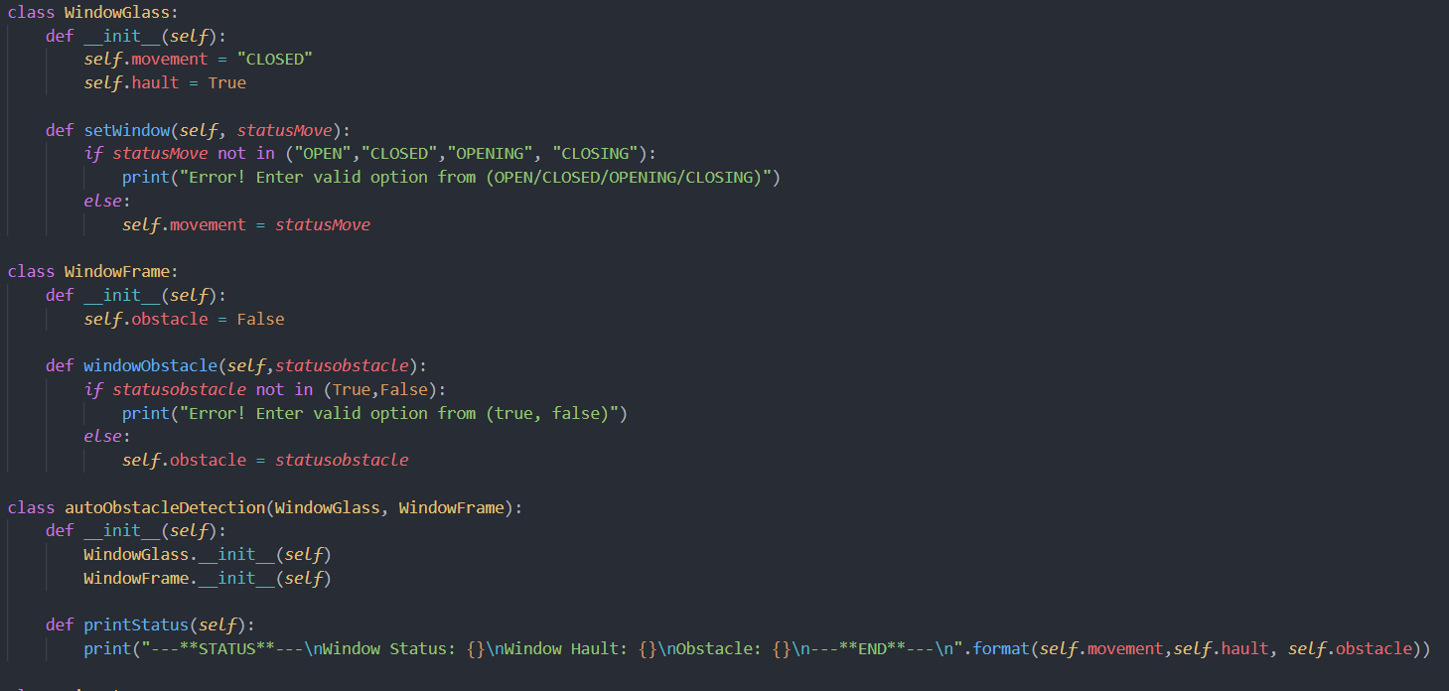
Classes and Entities for Behavior 4

Slide 26
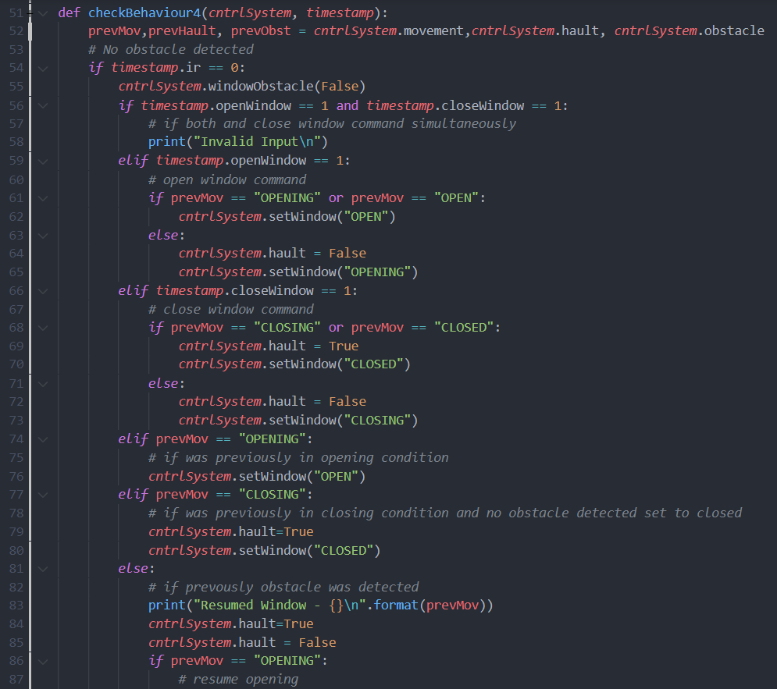
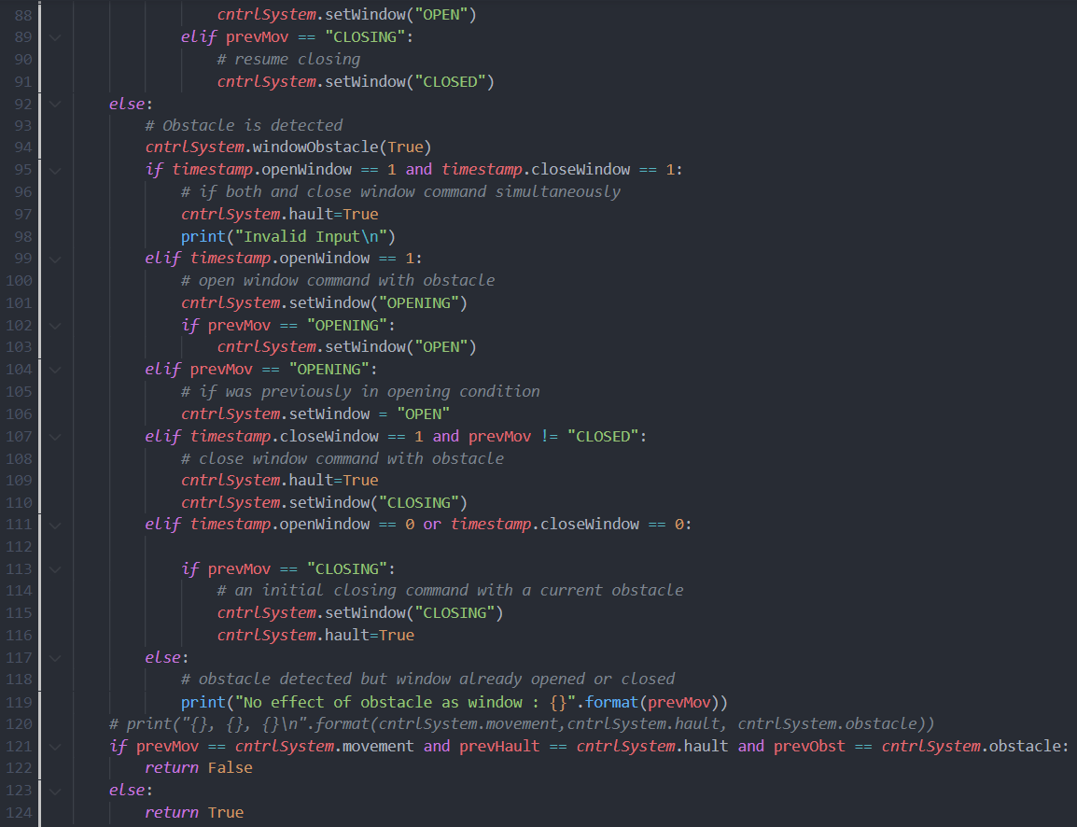
Context Behaviour Code for Behavior 4

Slide 27
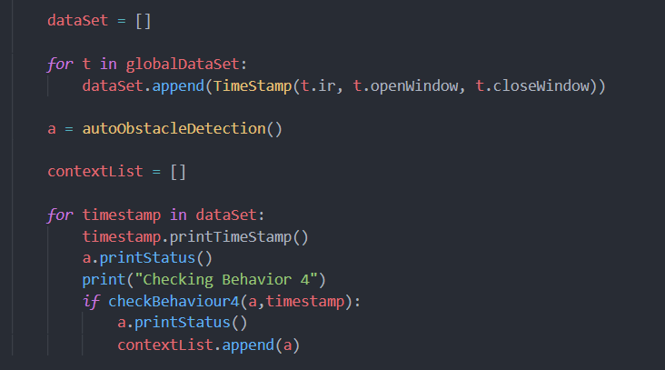
Main Function Example
The following snapshot is for Behaviour 4, almost similar to the rest of the behaviours

Slide 28
Unexpected / new context occurrence handling
Hardware Failure - Sensor Failure
Software Failure - Software Error due to Latency
Conflict Resolution - if the windows are rolled down, then you cannot close the sunshades
Erratic Behavior - sensor values are out of range

Slide 29
Optimizing the context aware rules
Non deterministic activation fault – There is no condition left in the context behavior check that prevents the system from activating necessary updates in the entity attributes. This could have been a problem if we hadn’t considered all the cases inside the behavior checks.
Dead Context fault – We have considered all the cases and rule properly, so that there is no condition that is not achievable in a real-life scenario.
Dead Decision fault – There are no decisions in the rules, that are waste and can’t be implemented. All the updates and decisions made by the rules are valid and can hold true for real-time situations.

Slide 30
Optimizing the context aware rules
Adaptation Race fault – Since we are updating the class attributes after every data instance, we use them only to check if there are any hidden constraints. The system doesn’t loop itself based on previous values and ensures that the new data instances are used to map the context behaviors.
Adaptation cycle fault – Repetition of context after one another is being controlled. We maintain controlled behaviors of the entities, so that the system isn’t stuck between two stages in a to-and-fro manner.

Slide 31
Reasoning the new context from the available context situation
We check the previous number of people before updating the temperature. This ensures that temperature is only changed when more number of people have entered or exited the car. This helps in maintaining a stable temperature for comfort.
For the passive behaviors, we have ensured that they are only asked if all the sensors are working and that proper conditions are being fulfilled. Otherwise, the user wouldn’t get a message on their screen.

Slide 32
Thank You

